Slide 1
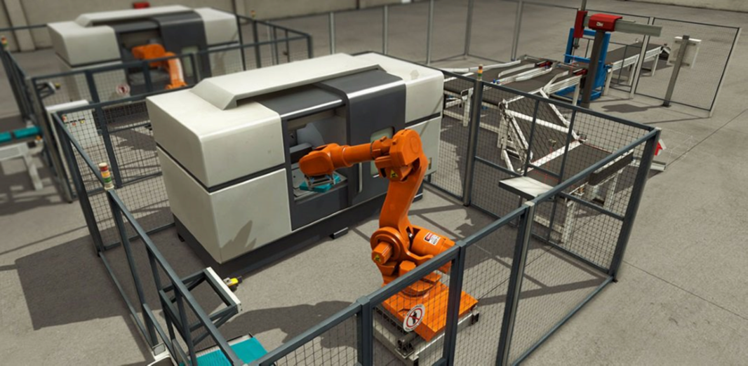
PLC Programming
FACTORY IO
SIMULATION SOFTWARE
Also see: https://docs.factoryio.com/ for more information

Slide 2
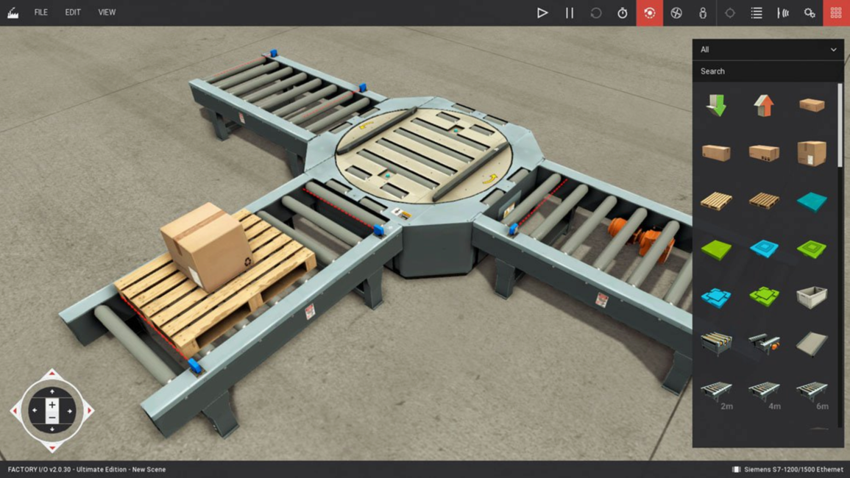
Getting Started
Let’s walk you through the basics of FACTORY I/O, including: working with cameras, creating/editing scenes and controlling them with external technologies. The goal is to allow you to be able to create a virtual factory and use it together with the PLC in the lab.

Slide 3
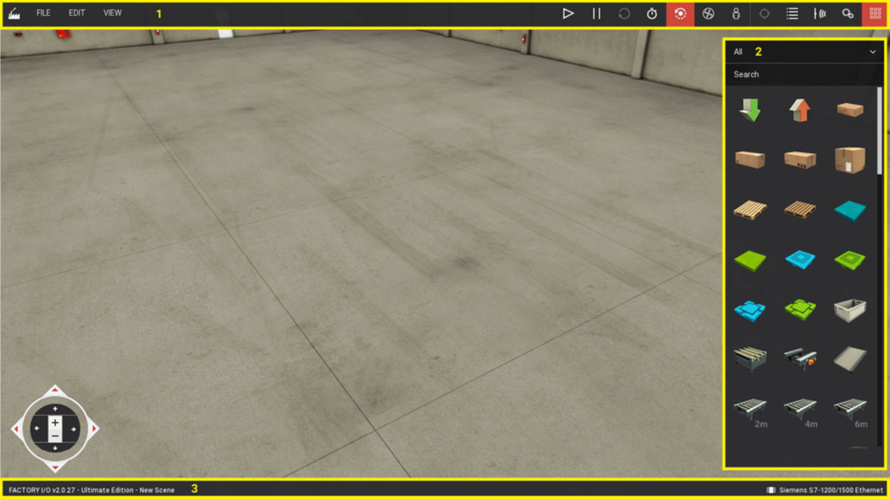
User Interface
If you are new to FACTORY I/O, it will be useful to get an introduction to a few basic concepts regarding the user interface and general workflow.
Tool Bar
Pallet
Camera Gizmo
Status Bar

Slide 4
Tool Bar
Welcome Menu
First Person Camera
Cameras Window
Sensor Tags
Orbit Camera
Follow a Part
Actuator Tags
Slow Motion
Fly Camera
Run/Edit
Pause
Reset
Palette

Slide 5
Navigating
One of the most important skills to learn in FACTORY I/O is how to use cameras. Cameras are used to navigate in the 3D space and are the key to interacting with parts or building new scenes. You can use three types of cameras:
Orbit (1), Fly (2) and First Person (3)
Get used to each type by testing the actions as described below. Keep in mind that each camera was designed for a special functional purpose

Slide 6
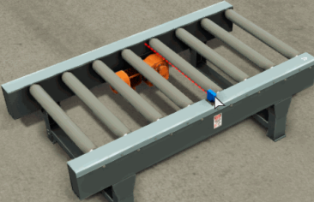
Orbit Camera
The Orbit camera is the default camera and should be used when building a scene. This is the only camera that allows you to move through parts without colliding with them.
It works by rotating around a point of interest (indicated by a white dot) which you define by Double Left-clicking on a part. Also, whenever a part (or parts selection) is moved, the point of interest is automatically set at the center of the part (press and hold Left shift to keep it at the original position). Once the point of interest is defined, you rotate the camera around it by holding the
Right Mouse Button (RMB) and dragging the mouse. New parts dragged from the Palette are created at the height defined by this point, except for parts which are typically placed on the floor, such as conveyors, stations, etc.

Slide 7
Orbit Camera
Double
Sets the camera point of interest. The camera will rotate around this point, and new parts will be created at this height.
LMB
RMB +
Rotates the camera around the point of interest.
Drag
MMB +
Translates the camera horizontally.
Drag
Mouse
Zooms the camera in and out.
Wheel
Backspace
Resets the camera to the default position and rotation.

Slide 8
Fly Camera
The Fly camera is used to move freely in the 3D space. This camera collides with scene parts but is not detected by sensors.
Double LMB
Looks the camera to where the mouse cursor is pointing.
RMB + Drag
Rotates the camera.
Mouse Wheel
Translates the camera vertically.
LMB + RMB
Moves the camera forward.
W | Up
Moves the camera forward.
S | Down
Moves the camera backward.
A | Left
Moves the camera left.
D | Right
Moves the camera right.

Slide 9
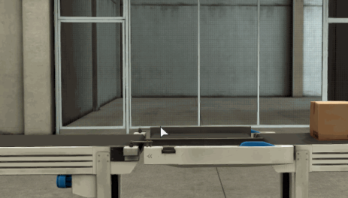
First Person Camera
The First Person camera represents a person of 1.8m (~5.9 feet) height. It should be used when simulating a person in a virtual factory. It collides with scene parts and, by default, is not detected by sensors.
You may set the First Person Camera to be detected by sensors using the console command camera.fp_detected = 1

Slide 10
First Person Camera
Double LMB
Locks the camera to where the mouse cursor is pointing.
RMB + Drag
Rotates the camera.
LMB + RMB
Moves forward.
W
Control
Action
Moves forward.
S
Moves backward.
A
Strafes left.
D
Strafes right.
Space
Jumps.

Slide 11
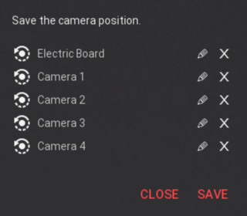
Save Camera Position
Useful to move around the scene while developing or troubleshooting.
Saves position and type of camera view
Edit description by clicking on edit icon.

Slide 12
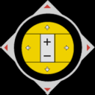
Camera Gizmo
You can perform most of the actions described above using the Camera Gizmo. You can show/hide the Camera Navigation gizmo on the View Menu.
Gizmo Area
Orbit
Fly
First Person
Translation
Translation
Translation
Rotation
Look
Look
(around point of interest)
Zoom
Vertical Translation
Jump

Slide 13
Follow a Part
This tool allows the Orbit Camera to follow a part. It's a great tool to keep up with a sequence of events and inspect possible failures. To start following a part, Select the Follow a Part icon on the toolbar and next Left-click on the part to follow. To stop following a part, Double Left-click anywhere in the scene or press the ESC key.
Homework:
During assignment #2 test, select a box to follow and test this option.

Slide 14
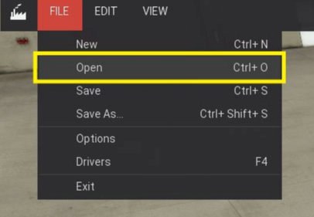
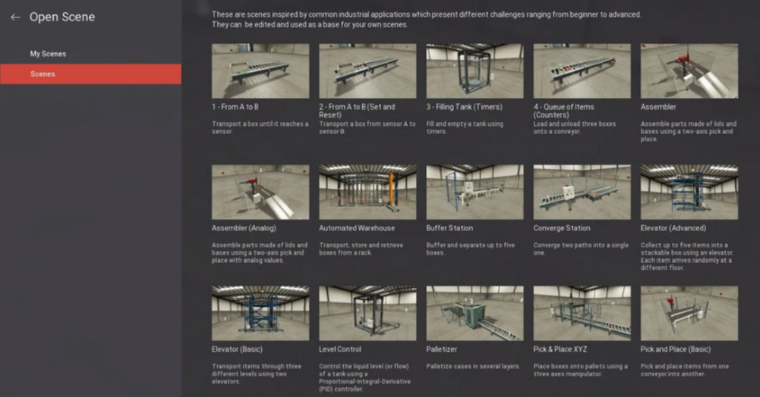
Opening a Scene
To open a scene choose Open from the File Menu (Ctrl + O) and select it from the list by Left-clicking.
FACTORY I/O comes with 21 Scenes, which can be accessed under the Scenes tab. You may also use any of these scenes as a starting point for a new one by opening and saving it with a custom name.

Slide 15
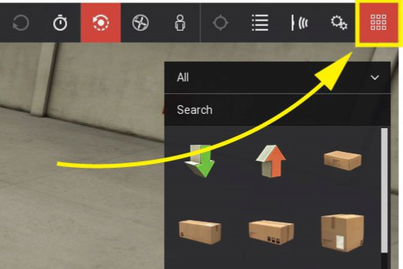
Creating a Scene
FACTORY I/O includes a large selection of parts inspired bu the most common industrial equipment. You create a virtual factory by placing and arranging these parts together. By following the next steps you will learn to create a simple sorting system.
Click on File, choose New (Ctrl + N) to create an empty scene.
On the Toolbar, select the Orbit camera - you should use the Orbit camera when editing. If the Palette is not visible click on the Palette icon.

Slide 16
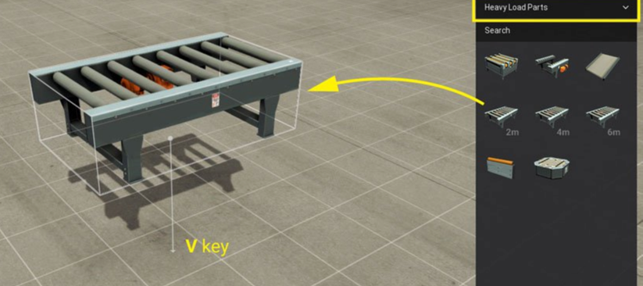
Creating a Scene
Choose Heavy Load Parts category from the Palette and Left-click and Drag a Roller Conveyor (2m) into the scene. When a new part is created it automatically becomes selected, indicated by a white bounding box.
When you drag a selected part it will move on the horizontal plane; to move it vertically press the V key and drag.

Slide 17
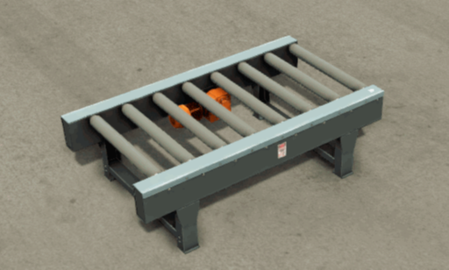
Creating a Scene
Set the camera point of interest on the edge of the conveyor by Double Left-clicking on it. Next, zoom in with the Mouse Wheel to get a closer view. Most parts will be created at the height of the point of interest, except those which are typically placed on the floor, such as conveyors, racks, stairs, etc.

Slide 18
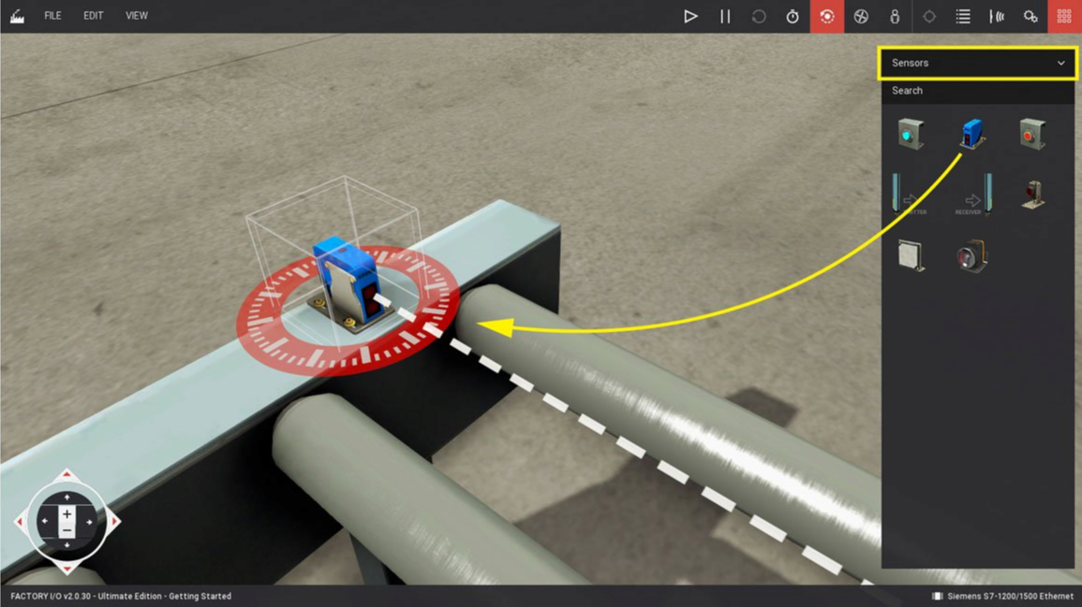
Creating a Scene
On the Palette, select the Sensors category and Left-click and Drag a diffuse sensor. While holding the LMB down, place the sensor at the edge of the conveyor.

Slide 19
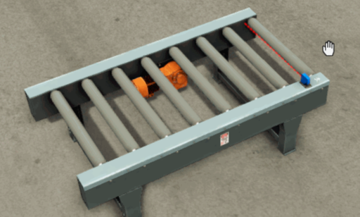
Creating a Scene
Right-click on the diffuse sensor and select Duplicate (Left Alt) from the context menu. Next, move the duplicated sensor to the other end of the conveyor.

Slide 20
Creating a Scene
7. Select all parts with the Rectangle Selection Tool by Left-clicking on the scene background and drawing a rectangle intersecting all parts to be included in the selection.
8. You can group parts together, which will allow you to easily select, move, rotate and duplicate them at once. Right-click on top of the selection and choose Group (Ctrl + G). At any moment, you can ungroup by Right-clicking on a group and selecting Ungroup (Ctrl + G). You can select a part within a group by holding the Ctrl key and Left-clicking.
9. With the previous group selected, Right-click on any part and chose Duplicate (Left Alt). Move the newly created group to a valid position and repeat the process, so you end up with three groups of conveyors and sensors. When a red box surrounds groups or parts, it means they are intersecting other parts and will be destroyed when switching from Edit to Run Mode.

Slide 21
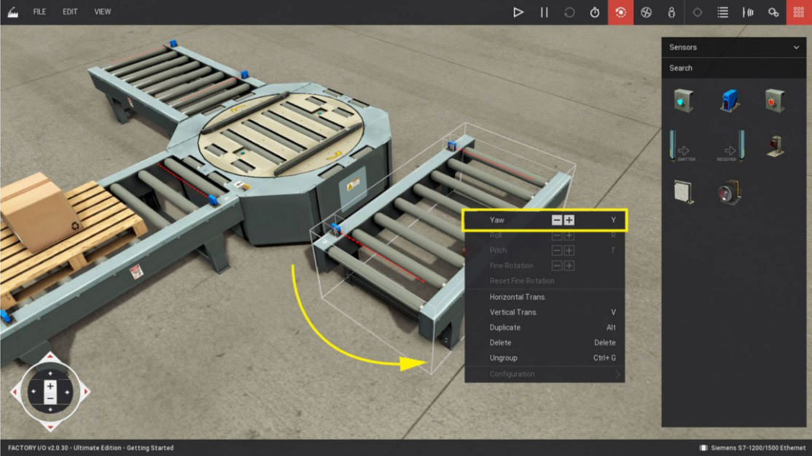
Creating a Scene
Select All from the Palette category list, drag a Turntable into the scene and place it in front of one of the conveyors. To properly place the other two conveyors at each side of the Turntable, you have to Rotate them first. Right-click on a conveyor and click the Yaw + or - button (Y) to rotate it. Most parts only allow rotations of 90º; sensors can rotate freely around the local up axis.

Slide 22
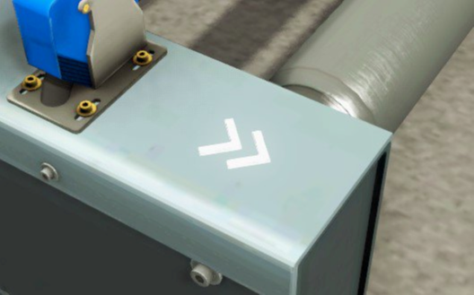
Creating a Scene
Finally, select the Items category and place a pallet on top of the first conveyor.
Now that your work is done, click on File and Save (Ctrl + S), give it a name (and optionally a description) and click on Save.
Note the conveyors, like most other parts, have a white arrow indicating the flow direction.

Slide 23
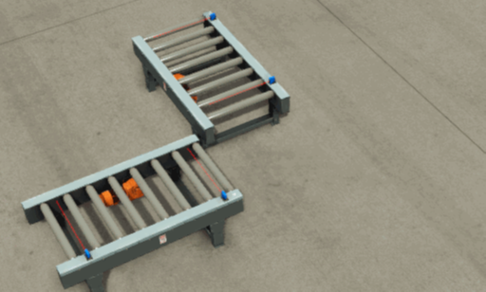
Other Useful Shortcuts

Slide 24
Manually Controlling a Scene
Before controlling a scene with an external controller (a PLC, for instance) it's recommended to test it manually. This way you can ensure that the scene layout works as expected. But first, you need to learn what Tags are and how they can be used to control parts.
Any part that is a sensor or actuator has at least one tag. Tags are made of a name and a value and can be of two different types: Sensors Tags and Actuators Tags. They can hold three different data types: Boolean for on/off values, Float for analog values (real numbers) and Integer for special data.
Tag values can be Forced at any moment, allowing you to play the role of the controller. To control your scene manually, you force the Actuators Tags, simulating a value coming from the controller.

Slide 25
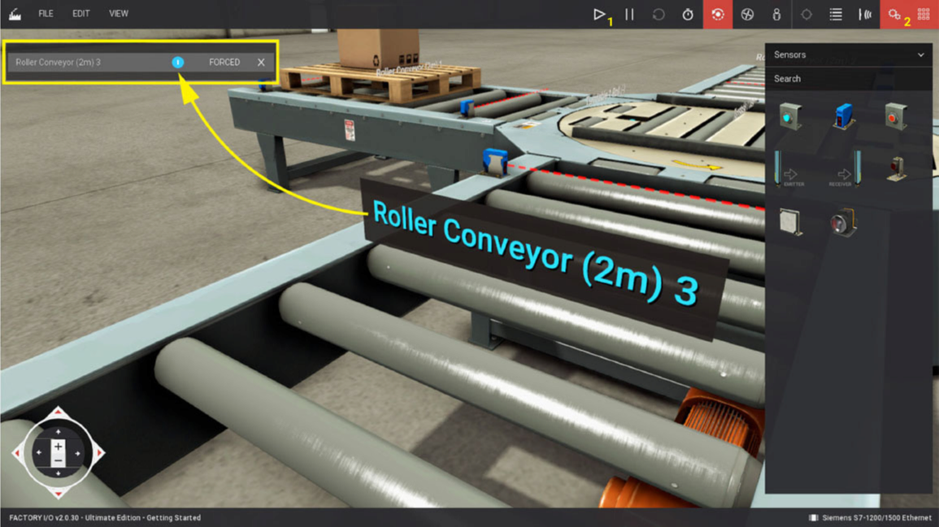
Manually Controlling a Scene
Using the scene created earlier, transport the pallet to the left conveyor.
Switch to Run mode by clicking the Play button (1).
Show the actuators tags by clicking on the Actuators Tags button (2).
Left-click on a tag to dock it. Once a tag is docked, you can force its value. You can Dock All Tags and Clear Docked Tags on the View Menu.

Slide 26
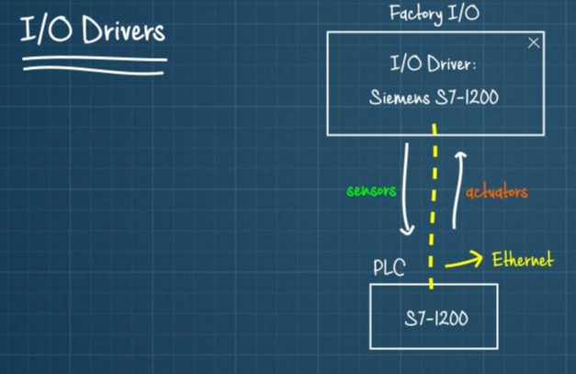
Controlling a Scene with a PLC
Now that you have created your factory it's time to control it with a PLC. But rst, you should learn what I/O Drivers and how to use them.
An I/O Driver is a built-in feature of FACTORY I/O responsible for "talking" to an external controller. FACTORY I/O includes many I/O Drivers, each one for a special technology. You select a driver in FACTORY I/O based on the
controller you want to use. Next, you configure this driver, so it knows how to "talk" to the controller and how to read and write I/O from it.

Slide 27
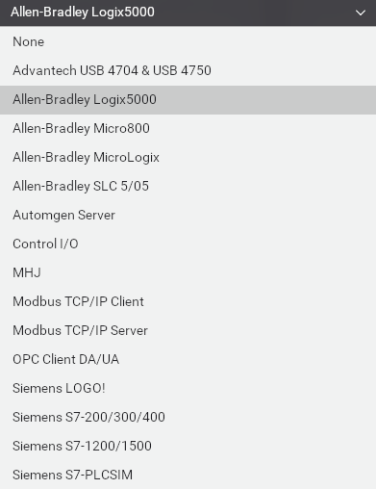
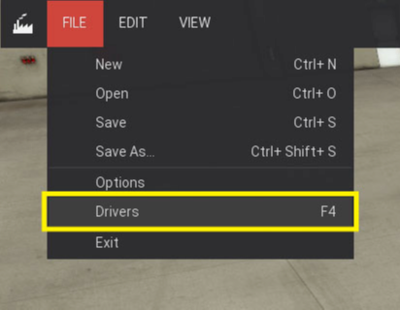
Controlling a Scene with a PLC
As an example, this tutorial shows how to use a Allen Bradley Logix5000 type PLC. However, most of the steps described here apply to other drivers as well.
Open the Drivers window by clicking on File and next on Drivers (F4). Alternatively, you may open the Drivers window by Left-clicking on the current driver displayed on the status bar.

Slide 28
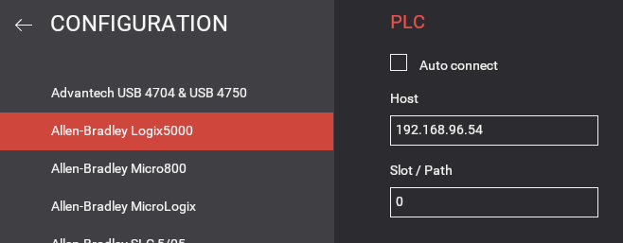
Controlling a Scene with a PLC
3. Click the Configuration button to setup the driver according to your PLC model and IP address.
4. Choose Allen-Bradley Logix5000 model and enter your PLC’s IP address in the Host box. Proceed to the next step by clicking on the Back Arrow (or the ESC key).

Slide 29
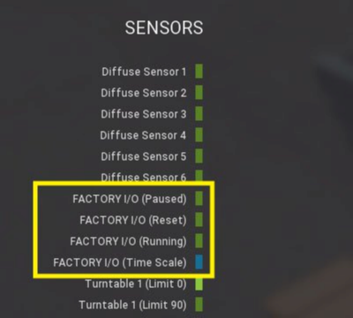
Controlling a Scene with a PLC
Press the Connect button to connect to the PLC. A successful connection will be indicated by a green sign displayed next to the drivers list.
You will find some "FACTORY I/O (...)" tags displayed in the sensors list (highlighted in the image below). These tags can be used by the controller so it can be "aware" of the status and time scale of the simulation (if it’s paused or running in slow motion).

Slide 30
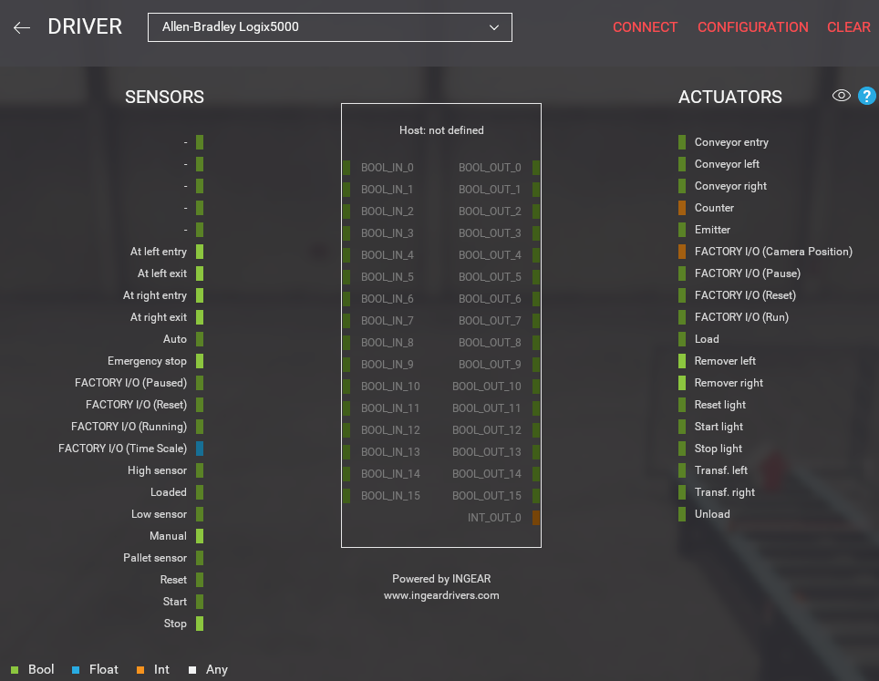
Controlling a Scene with a PLC
Start mapping tags by dragging and dropping each one onto the intended port. To remove a tag from a port just drag it back to the list. Once you have mapped all tags, set the simulation to Run Mode and test your PLC logic.

Slide 31
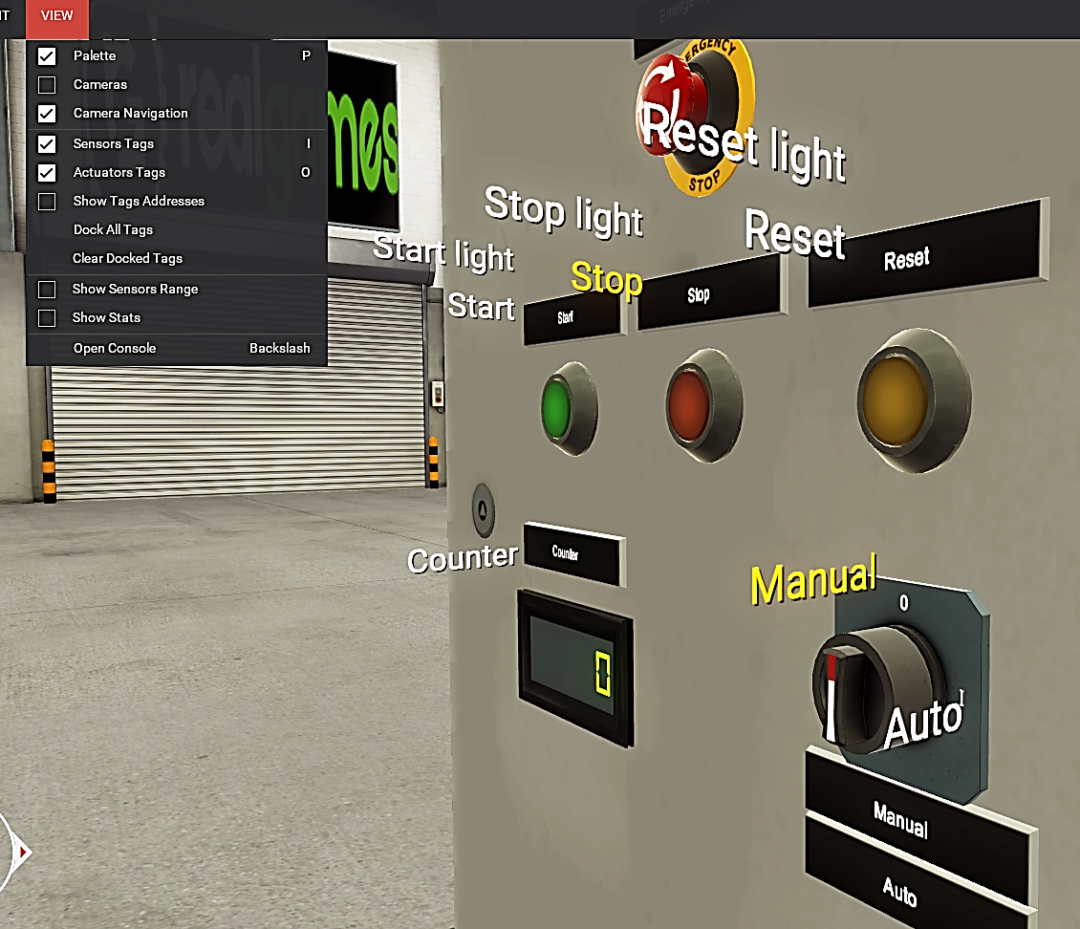
Displaying and Editing Tags
Under the View Menu, check off Sensor and Actuator Tags to have the labels for each appear next to the Input or Output.
These are the same labels used when assigning I/O so you may wish to rename a few.

Slide 32
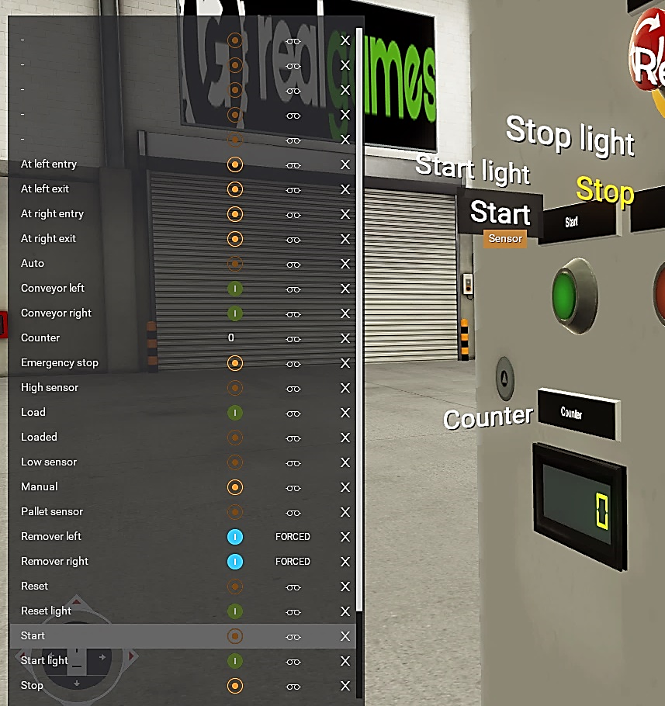
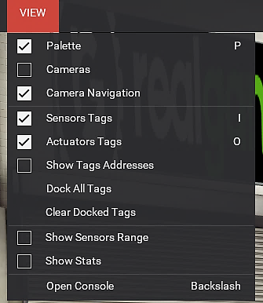
Displaying and Editing Tags
Find the Sensor or Actuator on the Tag list, double-click the field and enter the new text.
To find the Tag on the list, single click on the tag.
Clear Docked Tags when complete.

Slide 33
Supplemental Slides
( AB ←→ Siemens )

Slide 34
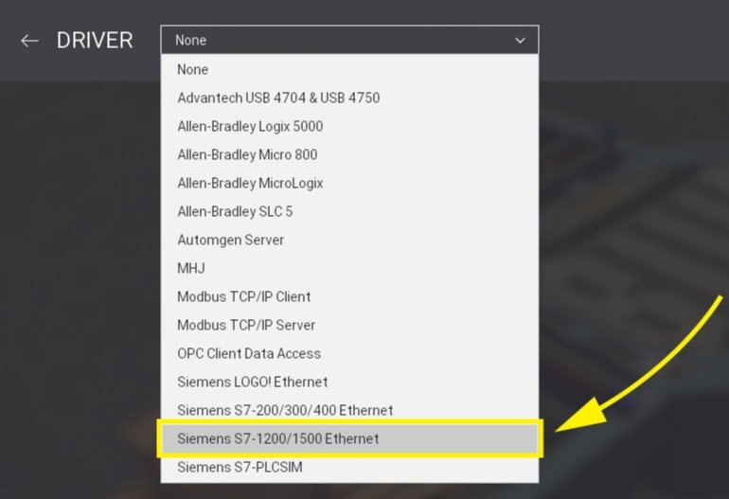
Controlling a Scene with a PLC
As an example, this tutorial shows how to use a Siemens S7-1200 PLC. However, most of the steps described here apply to other drivers as well.
Open the Drivers window by clicking on File and next on Drivers (F4). Alternatively, you may open the Drivers window by Left-clicking on the current driver displayed on the status bar.

Slide 35
Controlling a Scene with a PLC
3. Click the Configuration button to setup the driver according to your PLC model and IP address.
4. Choose S7-1200 model and ll in the Host eld with your PLC's IP address. Proceed to the next step by clicking on the Back Arrow (or the ESC key).

Slide 36
Controlling a Scene with a PLC
Press the Connect button to connect to the PLC. A successful connection will be indicated by a green sign displayed next to the drivers list.
You will find some "FACTORY I/O (...)" tags displayed in the sensors list (highlighted in the image below). These tags can be used by the controller so it can be "aware" of the status and time scale of the simulation (if it’s paused or running in slow motion).

Slide 37
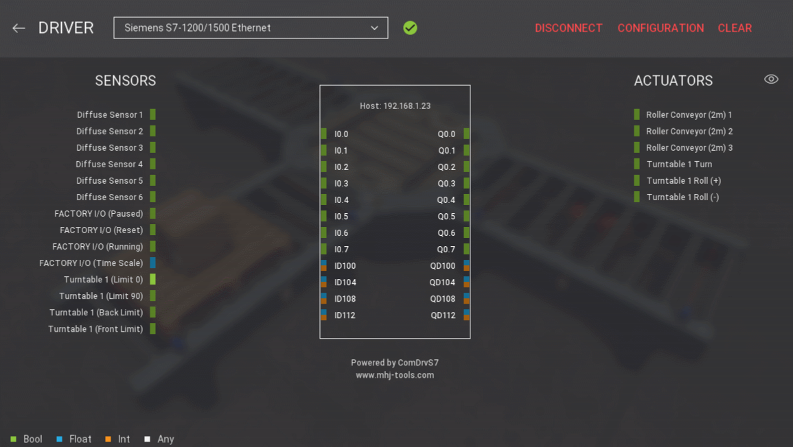
Controlling a Scene with a PLC
Start mapping tags by dragging and dropping each one onto the intended port. To remove a tag from a port just drag it back to the list. Once you have mapped all tags, set the simulation to Run Mode and test your PLC logic.

